Slide 1
jQuery Widgets and Plugins
L06 –Improve the Look
C273 – Advanced Web Application Development in PHP

Slide 2



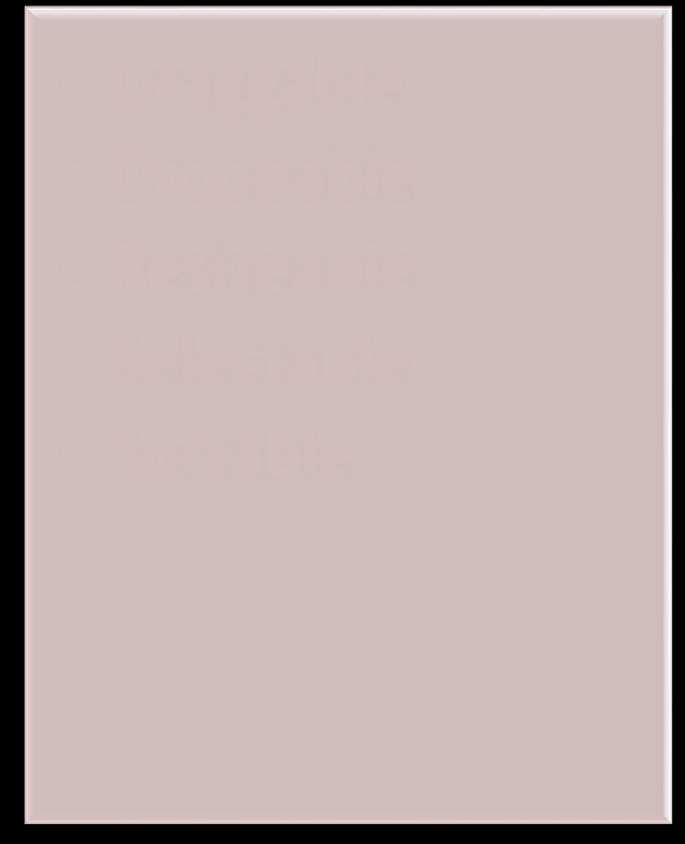
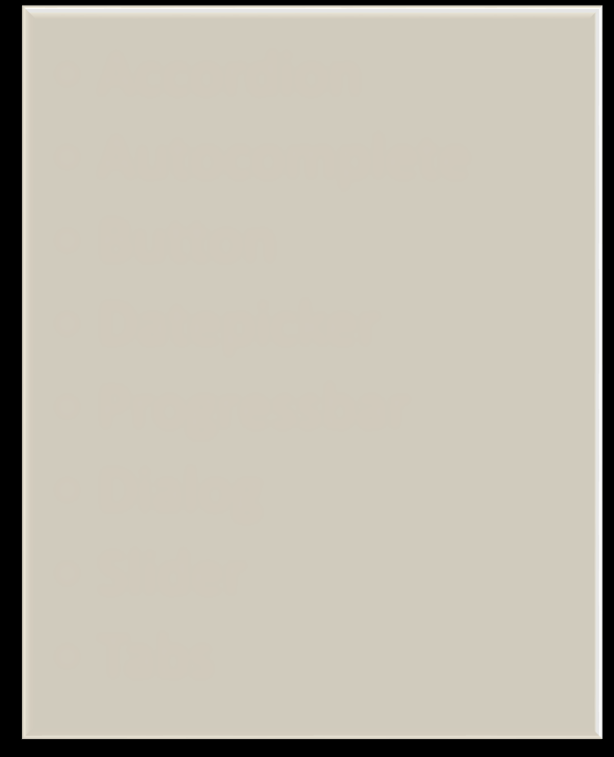

Using jQuery UI
Prebuilt set of functionality that adds interactive look and feel to the page
Interactions Widgets
Effects
Draggable
Droppable
Resizeable
Selectable
Sortable
Accordion
Autocomplete
Button
Datepicker
Progressbar
Dialog
Slider
Tabs
Add Class
Remove Class
Toggle Class
Switch Class
Hide
Show
Toggle
Color Animation
For more details, go to http://jqueryui.com/

Slide 3
Useful Bootstrap jQuery Plugins
jQuery UI Autocomplete
https://jqueryui.com/autocomplete/
jQuery UI Date Picker
https://jqueryui.com/datepicker/
Bootstrap Date Time Picker
http://eonasdan.github.io/bootstrap-datetimepicker/
Star Rating
https://github.com/wbotelhos/raty
Chart JS
http://www.chartjs.org/

Slide 4

Plugin dependency
These jQuery plugins require jquery.min.js to be included.
The Bootstrap jQuery plugins require the Bootstrap framework so you need to include bootstrap.min.css and bootstrap.min.js in your file.

Slide 5
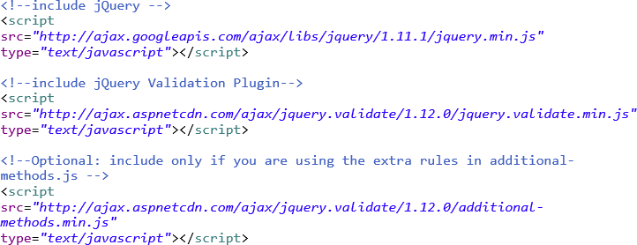
jQuery Form Validation
Use a tried and tested library to perform form validation
Website: http://jqueryvalidation.org/

Slide 6
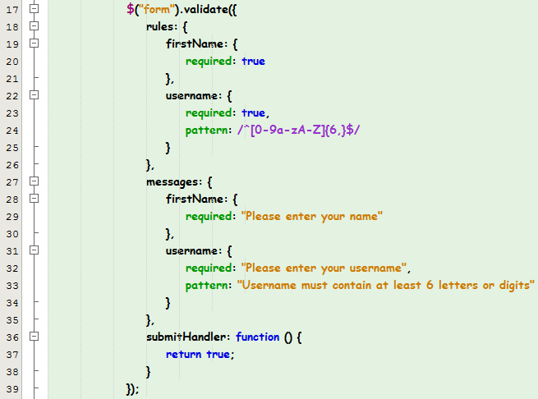
Example

Slide 7
Chart JS
Chart.js comes with built-in chart types:
line
bar
radar
polar area
doughnut and pie
bubble
https://cdnjs.cloudflare.com/ajax/libs/Chart.js/ 2.7.1/Chart.bundle.min.js

Slide 8
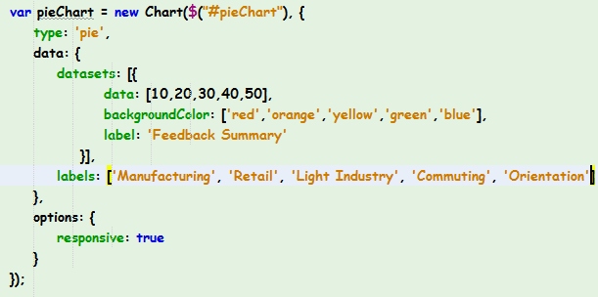

Chart JS

Slide 9
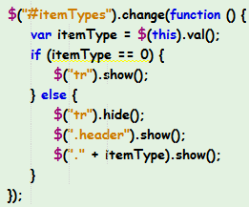
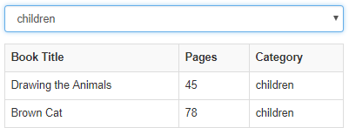
Solution – dropdown change
Trigger the function if there is a change in value for HTML elements with CSS class "itemTypes"
If value = 0, show all <tr>
Otherwise, show only the appropriate
<tr>

Slide 10
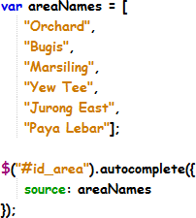
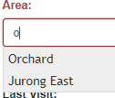
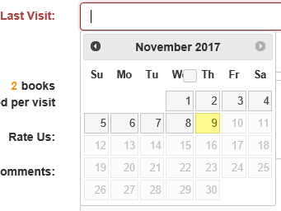
solution – autocomplete (jquery UI)
autocomplete
datepicker

Slide 11
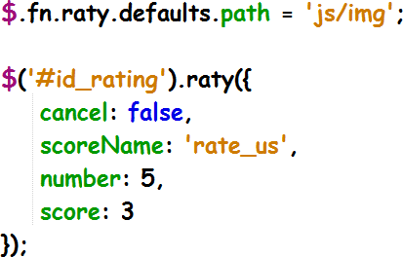

Solution – star rating (jquery plugin)
Folder for star images
Parameters for star rating
enables star rating

Slide 12
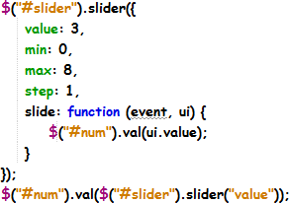
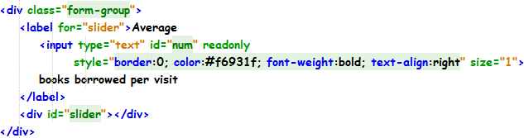
Solution – slider (jquery plugin)
parameters
Show slider value

Slide 13
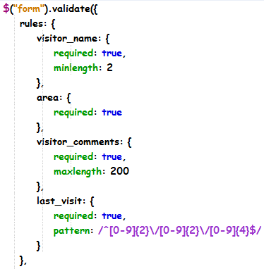
Solution – jQuery Form Validation
Use the input name
Using regular expression to specify the correct format

Slide 14
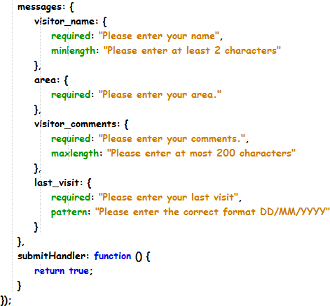
Solution – jQuery Form Validation
An optional container to customize your error messages
After successful form validation, perform these codes

Slide 15
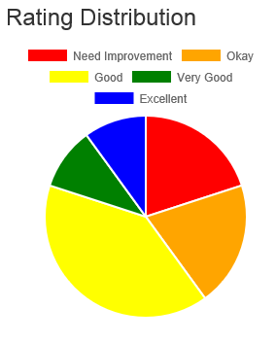
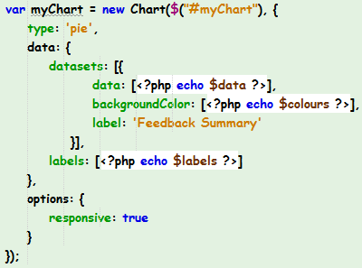
Solution – pie chart (jQuery plugin)

Slide 16
What you learnt today
Download JQuery UI library and apply to webpages
Identify the various widgets and their purpose
Apply Autocomplete, Datepicker, Slider, jQuery Form validator, Star rating and Pie charts on web pages.
Integrate Bootstrap and JQuery libraries into a single web page

